Slide 1
AFEX Setup – Student Guide

Slide 2
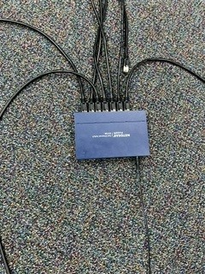
Step 1
Make sure all ethernet cables are plugged into blue box in middle of floor or mounted to cabinet. Ensure the Host (MC) computer is also plugged into the room AV system via HDMI.

Slide 3
Step 2
Log into each computer using username: USAF_Admin
Leave the password field blank.
Ensure that the network connection is active.
If you do not get a network connection, the cable is either INOP or loose. Replace the cable if this happens. If replacing the cable does not work, then replace the computer with an extra one from room D206. Notify Maj Davidson of the INOP computer and do not place the INOP computer with the operational computers in room D206.

Slide 4
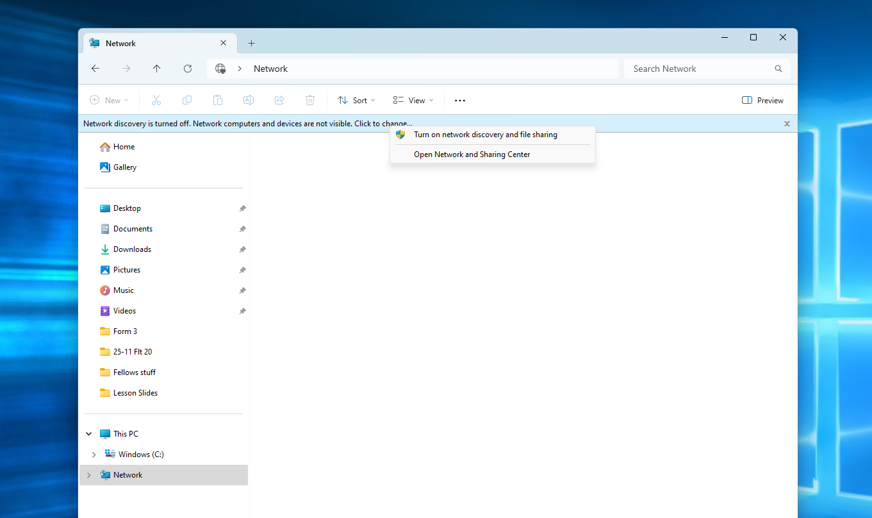
Step 3
On all computers, open file explorer. Select network on left hand side.

Slide 5
Step 4
Click the yellow banner that states “network discovery is turned off…” Select “Turn on network discovery and file sharing.” Click “Ok” on pop up box.

Slide 6
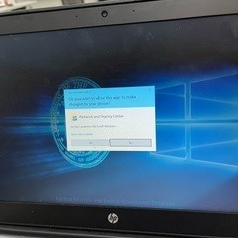
Step 5
Click “yes” on the next pop up box
Click yes

Slide 7
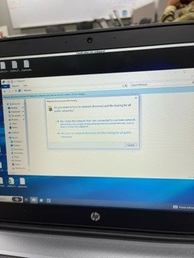
Step 6
Then click “no” on the next pop up box
Click no

Slide 8
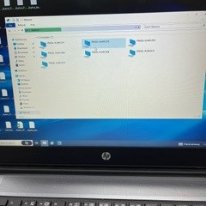
Step 7
You should now see seven computers in the network section, if you don’t, check ethernet connections and repeat steps 2-6 on computers not connected.

Slide 9
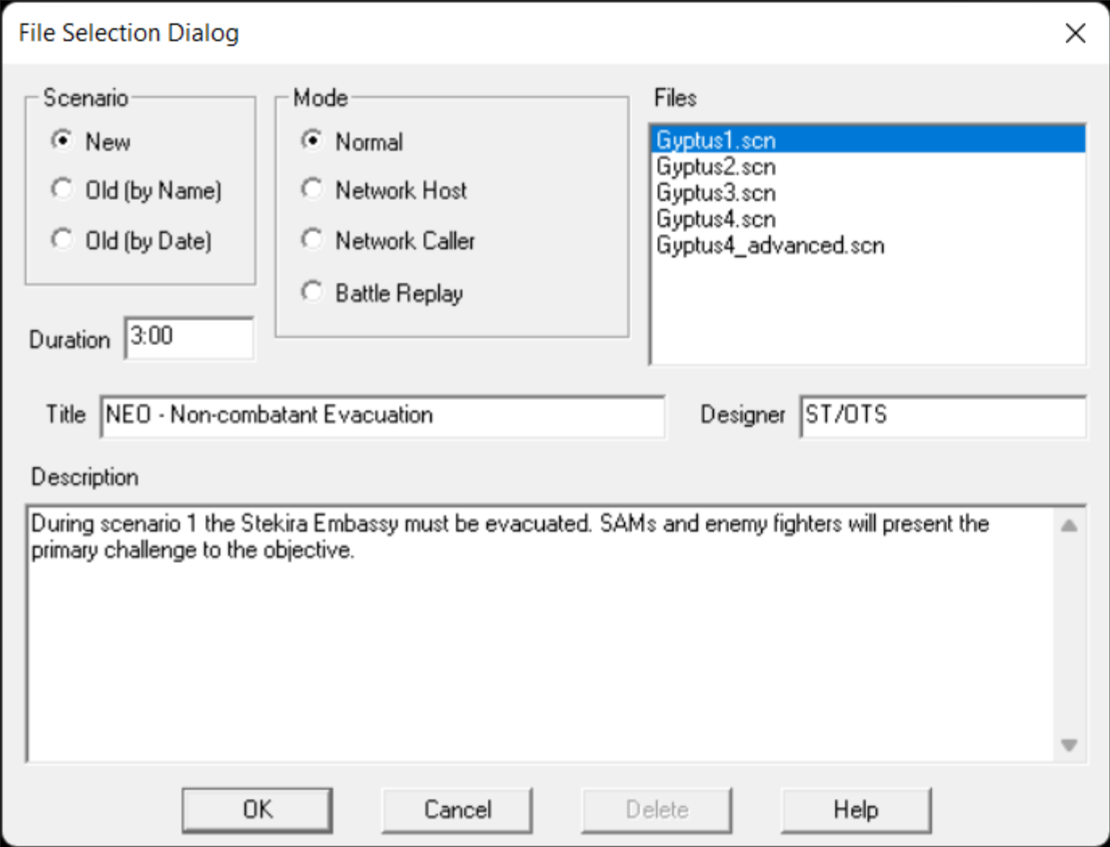
Step 8: Host only
For the host computer, select Network Host and Gyptus 1.
Select Network Host
Select Gyptus 1

Slide 10
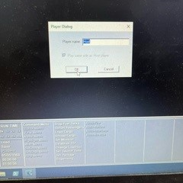
Step 9: Host only
For the host computer, change player name to Mission Commander.

Slide 11
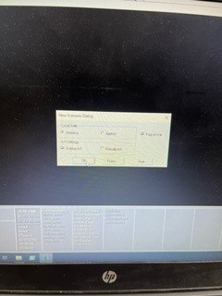
Step 10 : Host only
Select “OK”

Slide 12
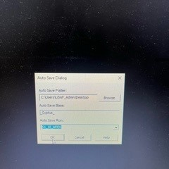
Step 12: Host only
Select Browse

Slide 13
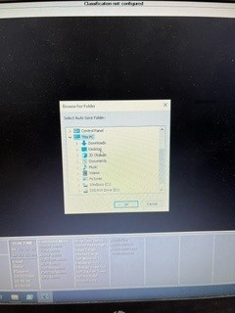
Step 13
Select This PC
Select Desktop
Select Ok

Slide 14
Step 14: Host only
Under Auto Save Run select first option

Slide 15
Step 15
For all other stations, select “Network Caller”.
Network caller

Slide 16
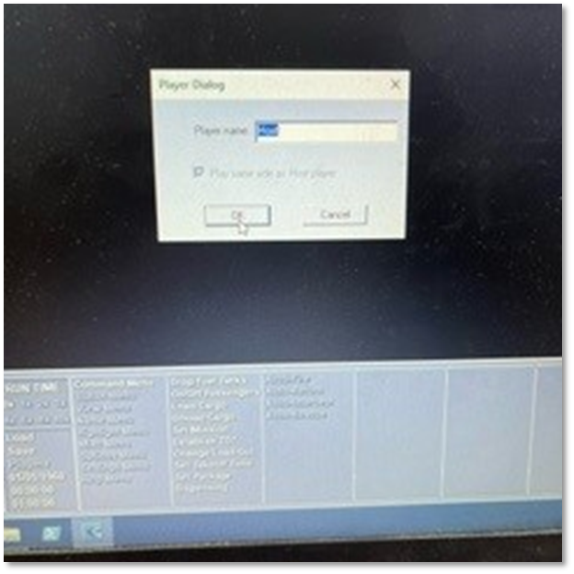
Step 16
Change name to position on computer (e.g. DCA, ISR, Air Mobility, Strat Bomber, etc.)

Slide 17
Step 17
To find the Host IP address:
Have the host open the command prompt on his/her computer by typing command prompt in the search bar.
Once the command prompt is open, type in ipconfig, and press enter. The IP address should be 192.168.1.X (X will be some number).
This IP address should be entered as the IP address for the other PCs when prompted to enter an IP address in AFEX.

Slide 18
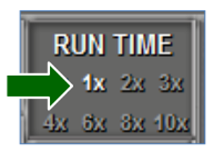
Step 18
If you want 3x speed, enter password 2020

